Slide 1
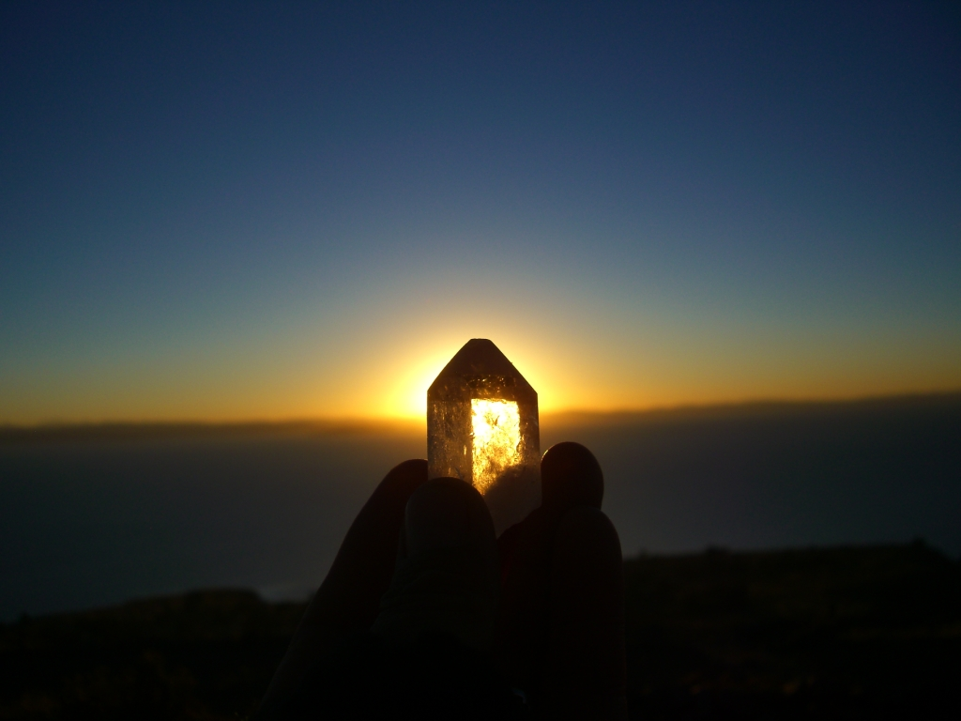
SACRED JOURNEY PROGRAM FOR PERU AND BOLIVIA
September 3rd through September 14th, 2010
15 Days – 14 Nights
With Special Ayahuasca Ceremony in the Sacred Valley, Peru
Cost per person, double occupancy: $3,950.00 U.S.*

Slide 2
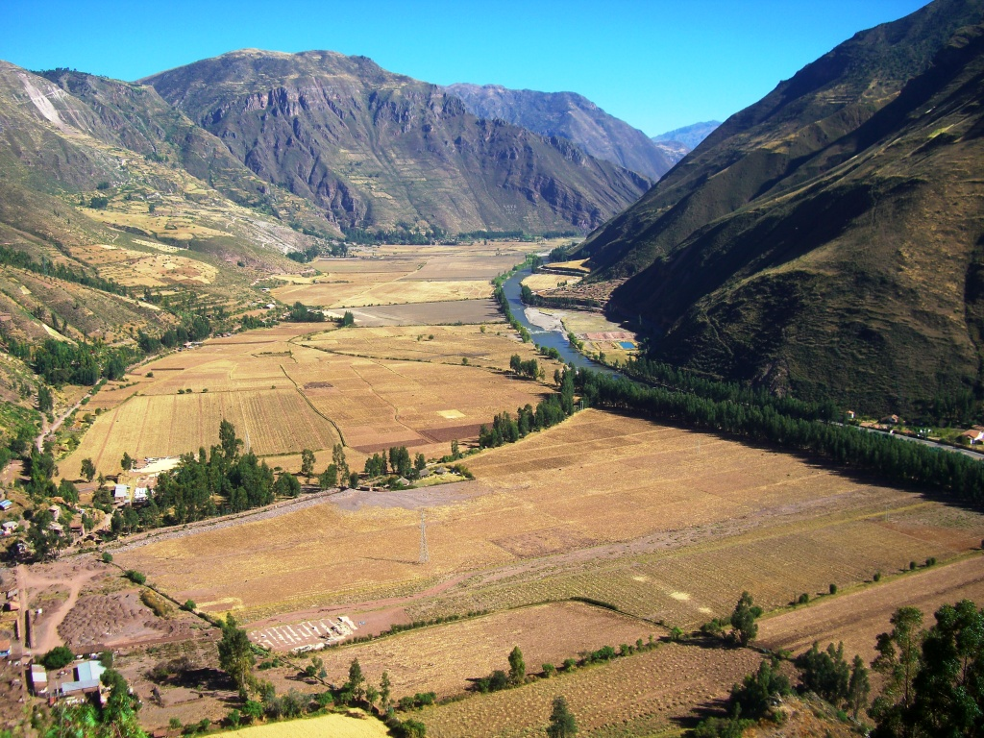
Day 2. Saturday September 4. Fly from Lima to Cusco. Flight is included. Transfer from airport to hotel in Pisac located in the Sacred Valley of the Incas. Overnight in Pisac

Slide 3
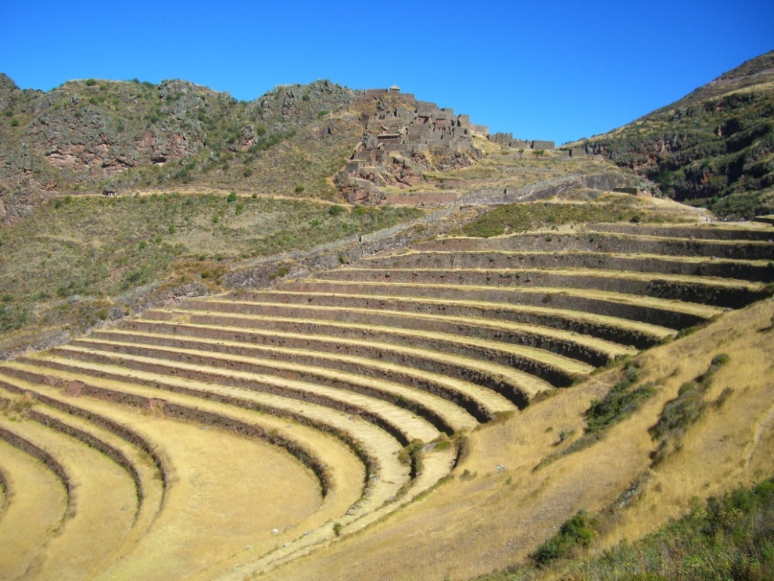
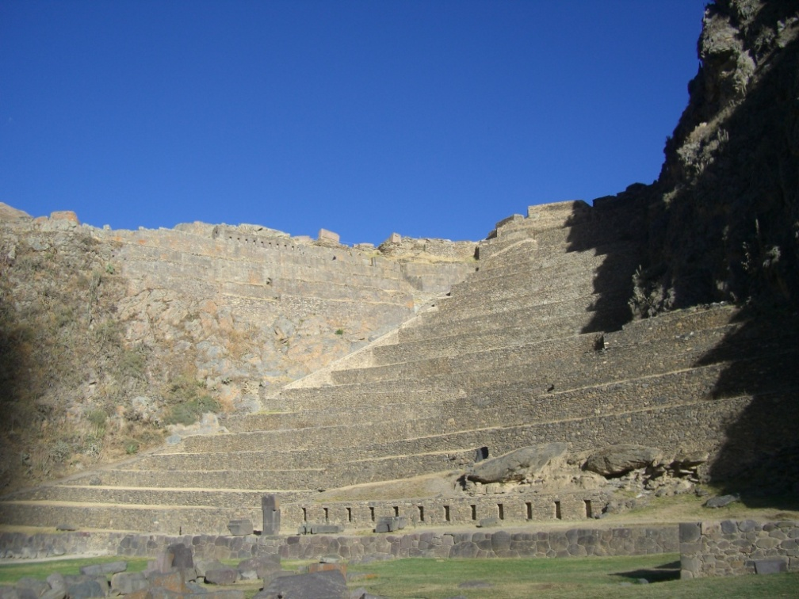
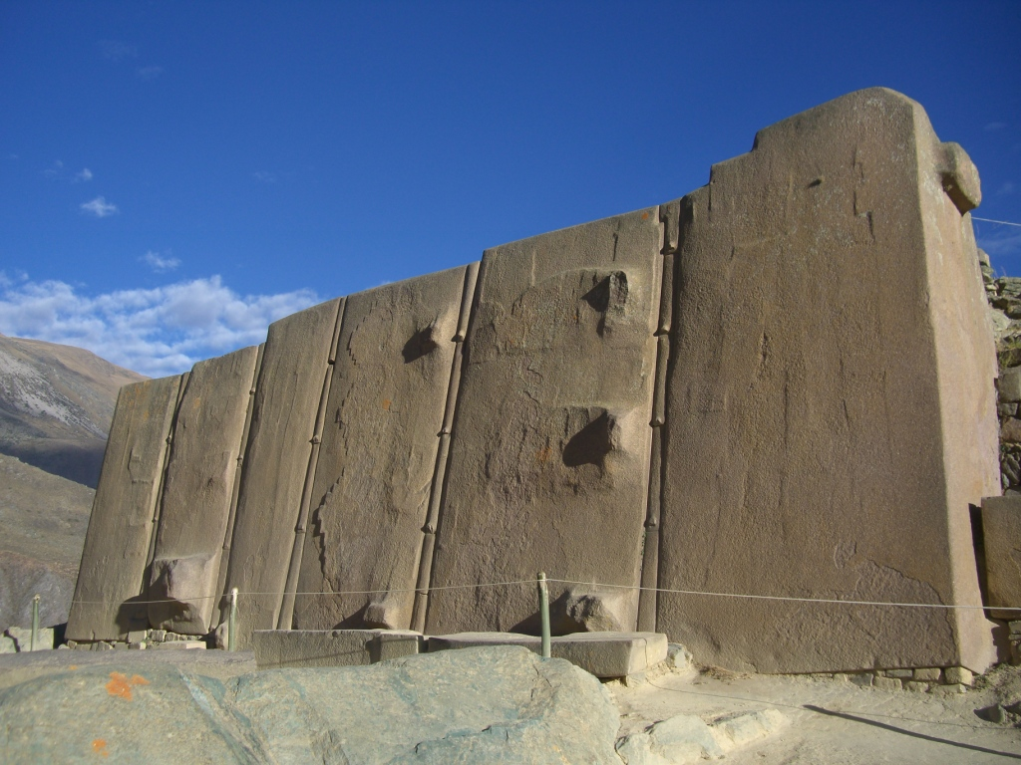
Day 3. Sunday September 5. After breakfast we will visit the agricultural and urban center, Pisac where will have a ceremony dedicated to the Sacred Valley to ask for permission for our pilgrimage through the different power centers located throughout the Valley, to the finished our visit we continue our voyage to Urubamba for enjoy a variety of typical dishes of the region. In the afternoon after lunch we will be visit the archaeological complex of Ollantaytambo, and later we will go to the train station where we board our transport to Machu Picchu. Overnight in Machu Picchu village

Slide 4
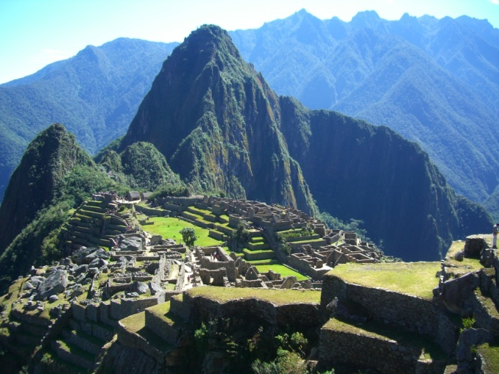
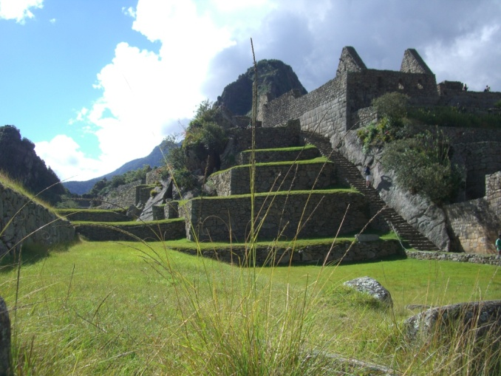
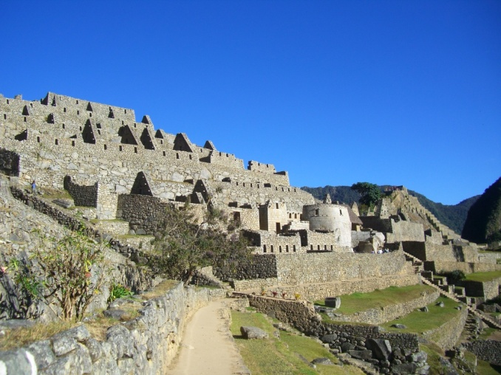
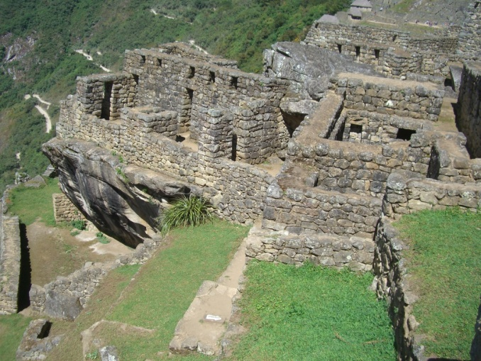
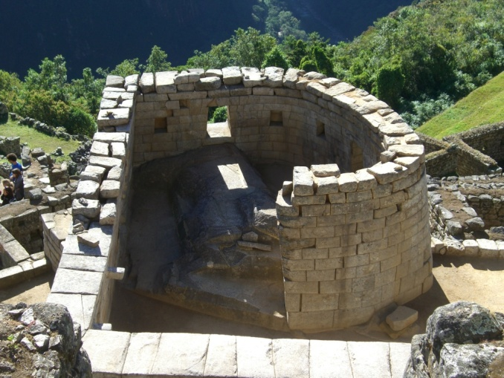
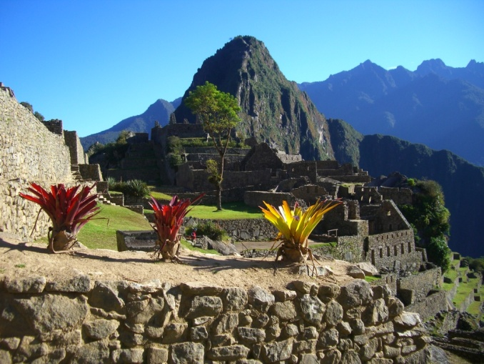
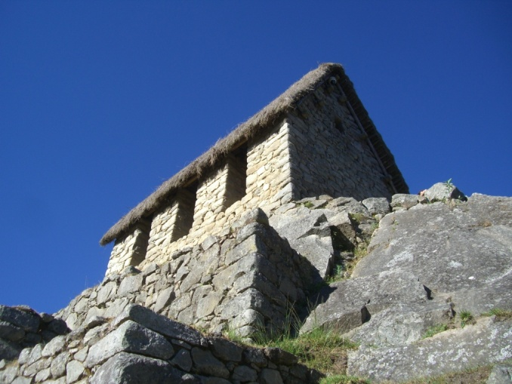
Day 4. Monday September 6. Very early in the morning after the breakfast we will ascend to the crystal city, Machu Picchu. In the temple known as Inti Watan we can appreciate the sunrise and we can receive our initiation like Sons of the Sun, then we will visit various sacred places in this mystical and important Inca city. In the afternoon after lunch we will take our train to the Sacred Valley where we spend the night. Overnight in the Sacred Valley

Slide 5
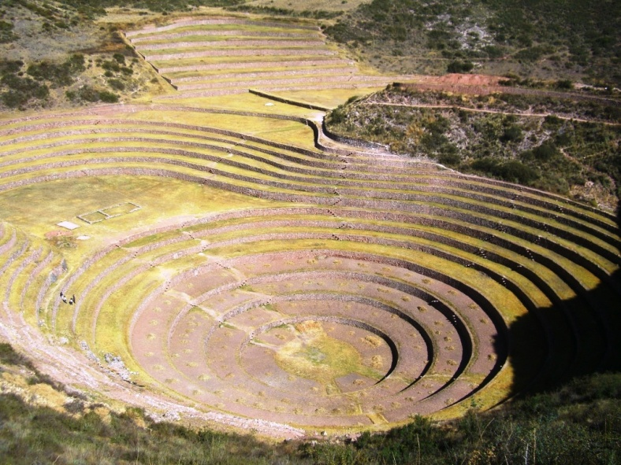
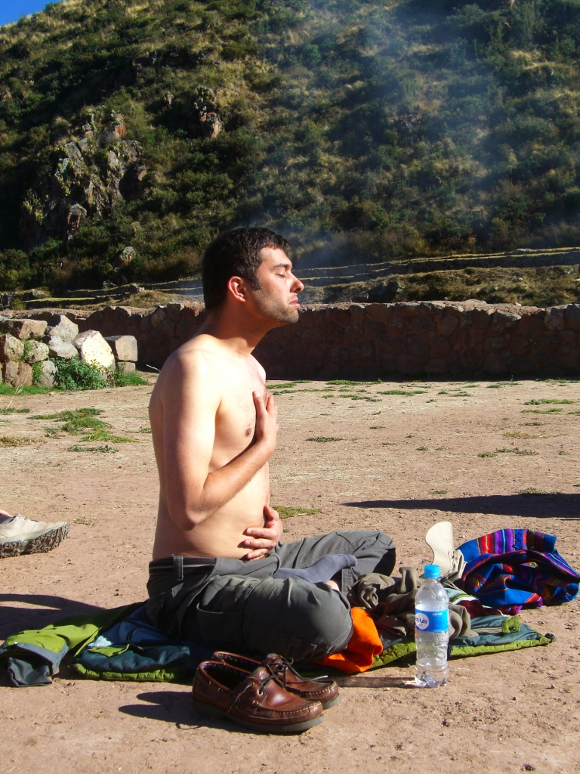
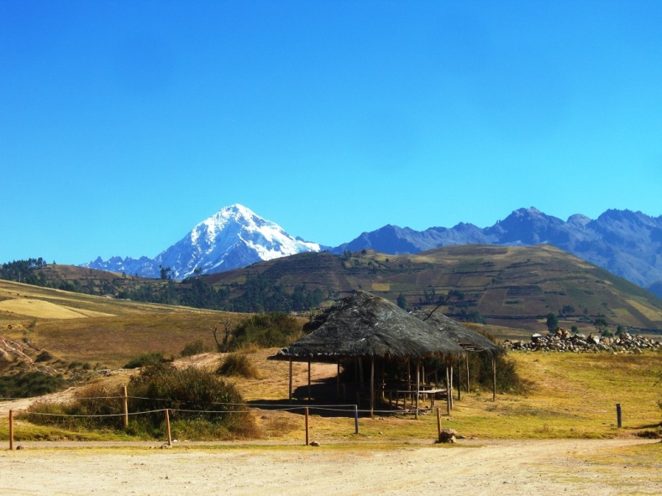
Maras Moray
Day 5. Tuesday September 7. In the morning we will visit the craft center of the Seminar and Maras Moray where we prepare for Ayahuasca ceremony. After lunch we will receive a talk on power plants. In the evening we will perform the Ayahuasca Ceremony (optional). Overnight in the Sacred Valley.

Slide 6
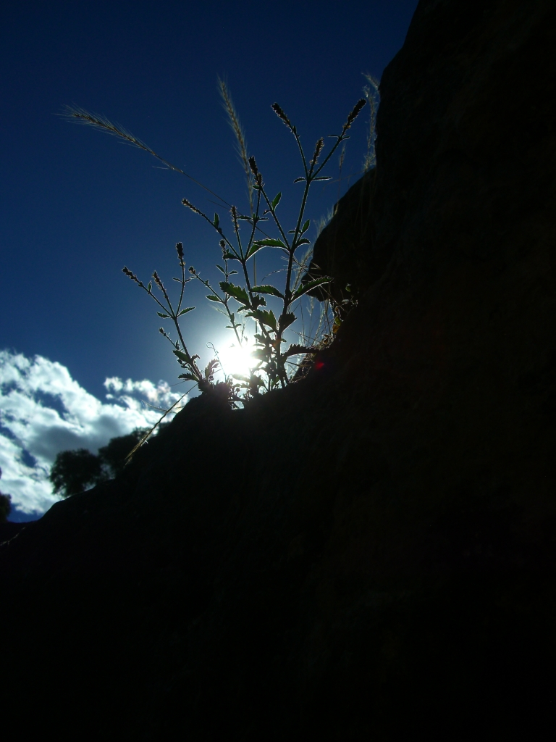
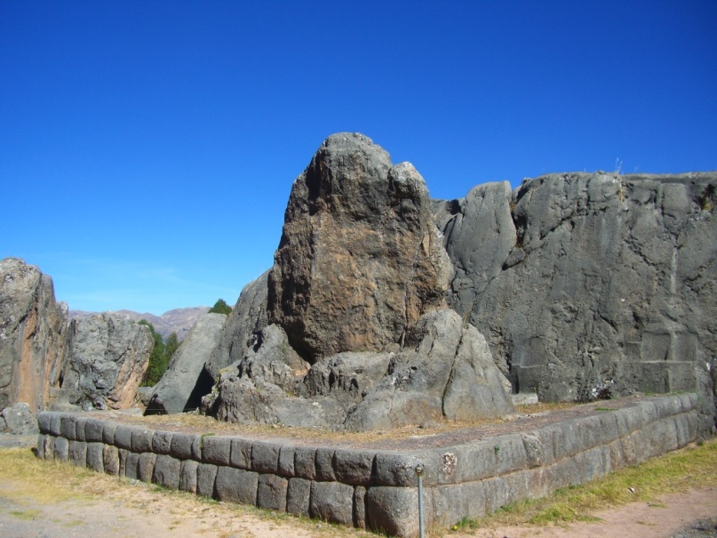
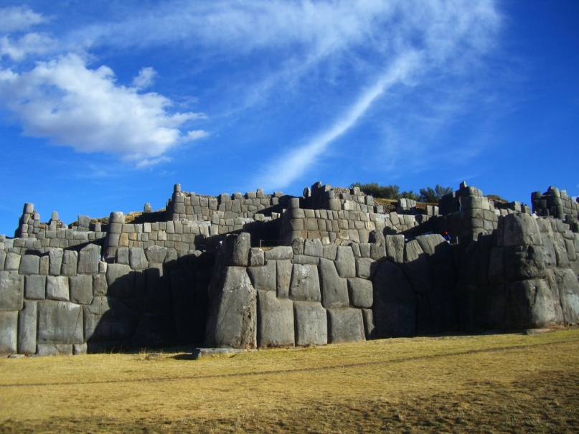
Day 6. Wednesday September 8. After the Ayahuasca Ceremony on the next day, we will visit Chincheros, Saqsaywaman, the Sun House, Qenqo and the Temple of Qoricancha. Free afternoon in Cusco. Overnight in Cusco.

Slide 7
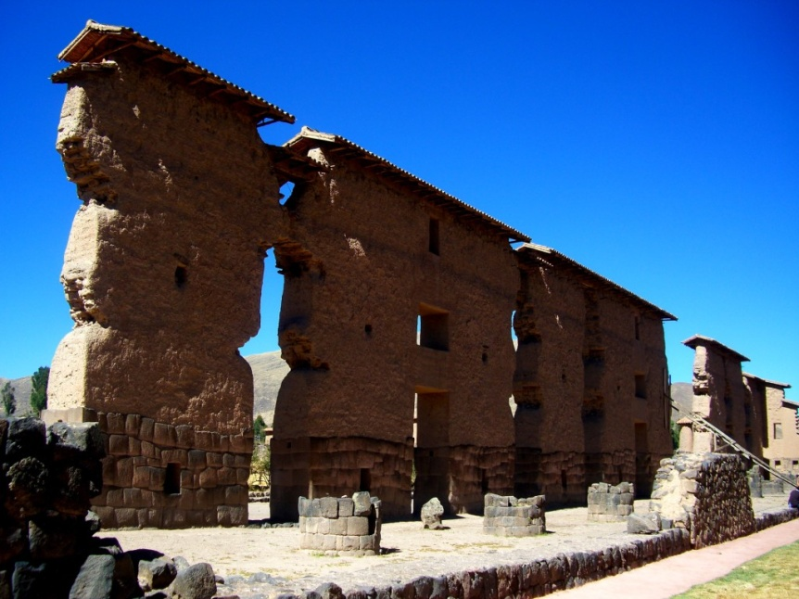
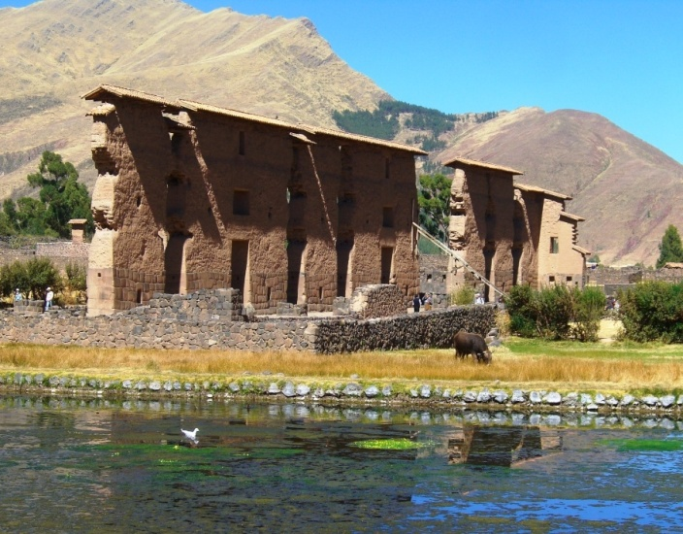
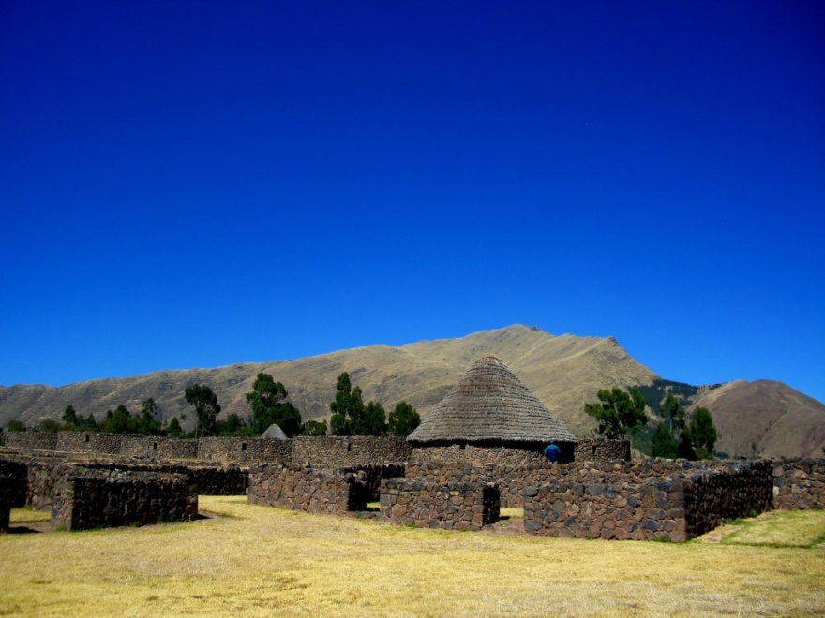
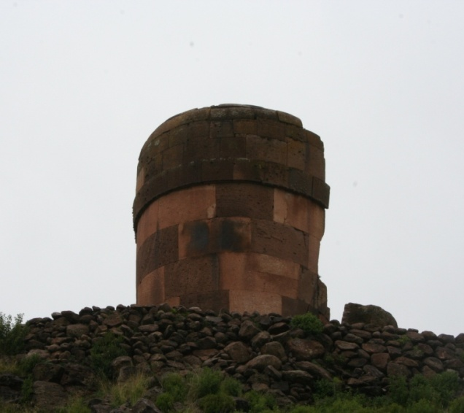
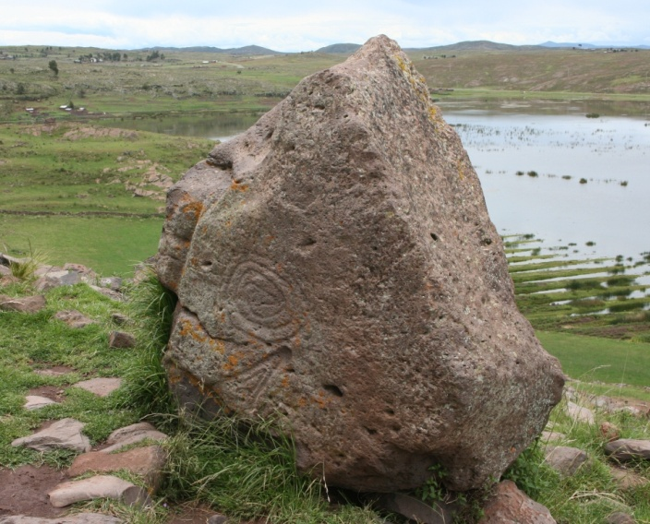
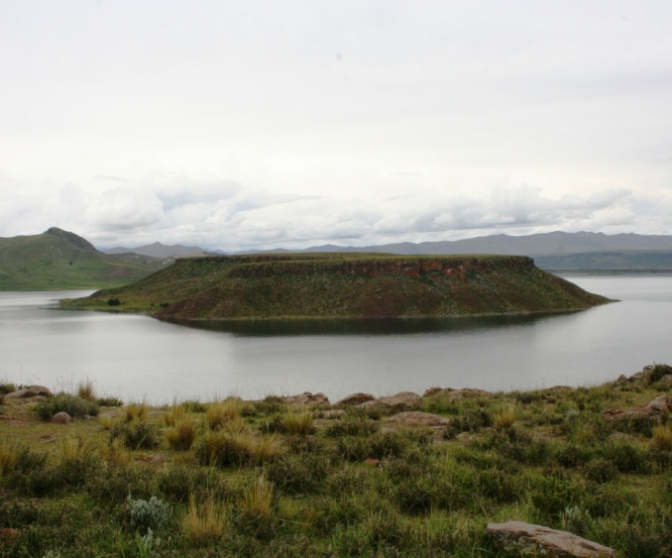
Day 7. Thursday September 9. Travel to Puno City. On this trip we will visit Raqchi, the temple dedicated to the god Wiraqocha and Sillustani's Center. Then through the border of Cusco and Puno, where the sacred river "Willca Mayu" is born, reaching the city of Puno in the evening. Overnight in Puno

Slide 8
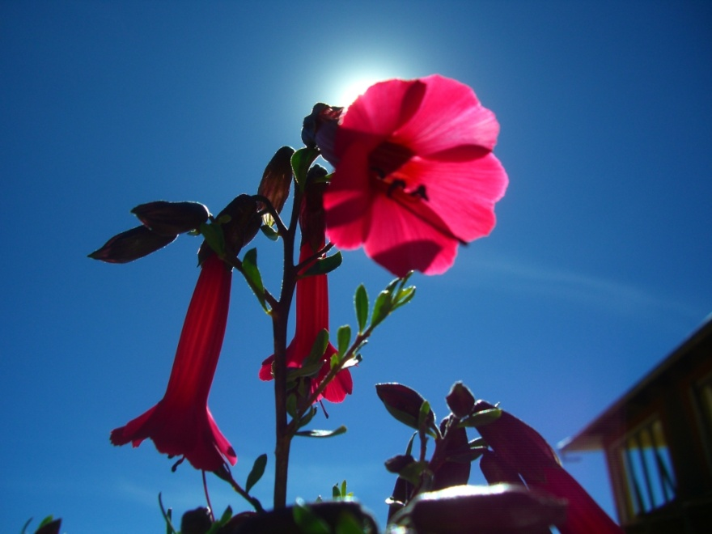
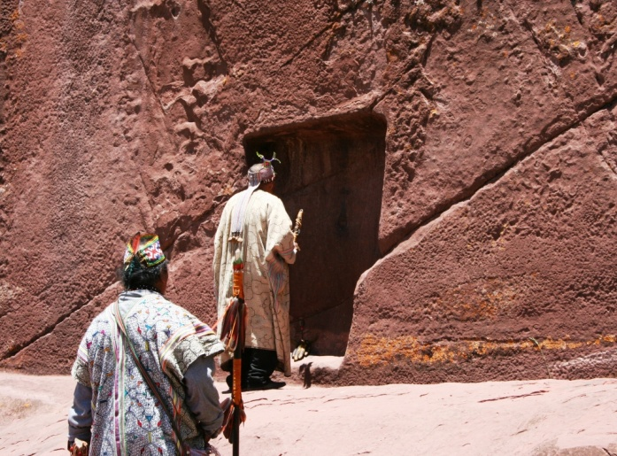
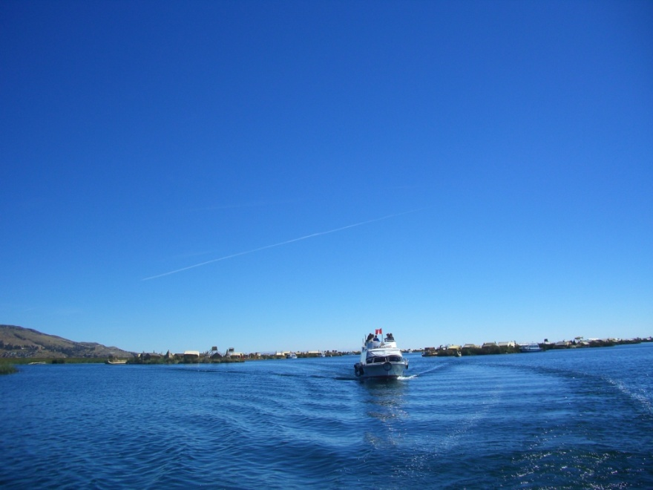
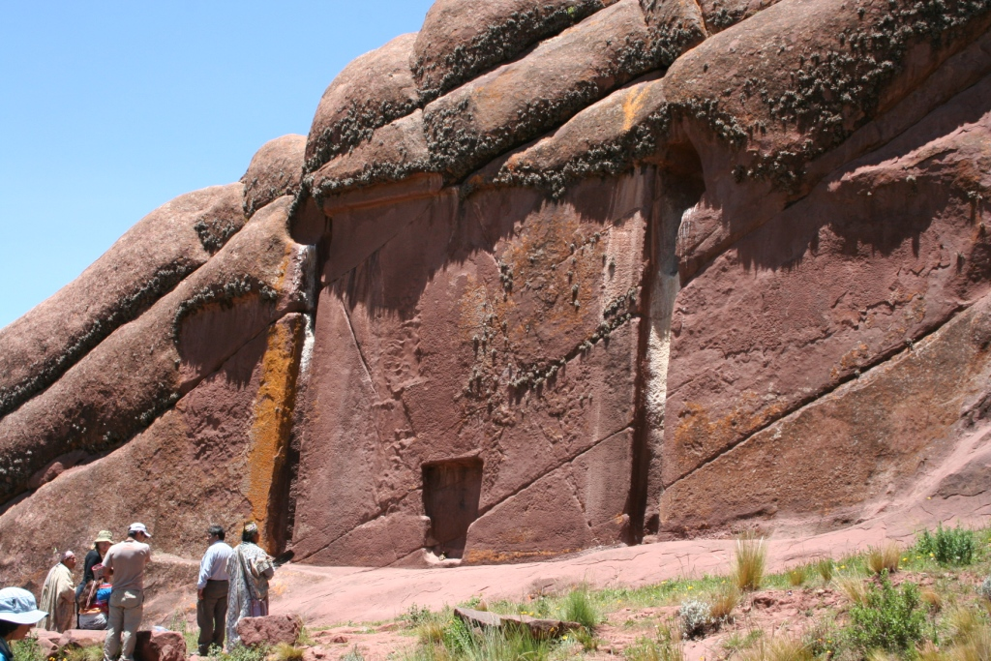
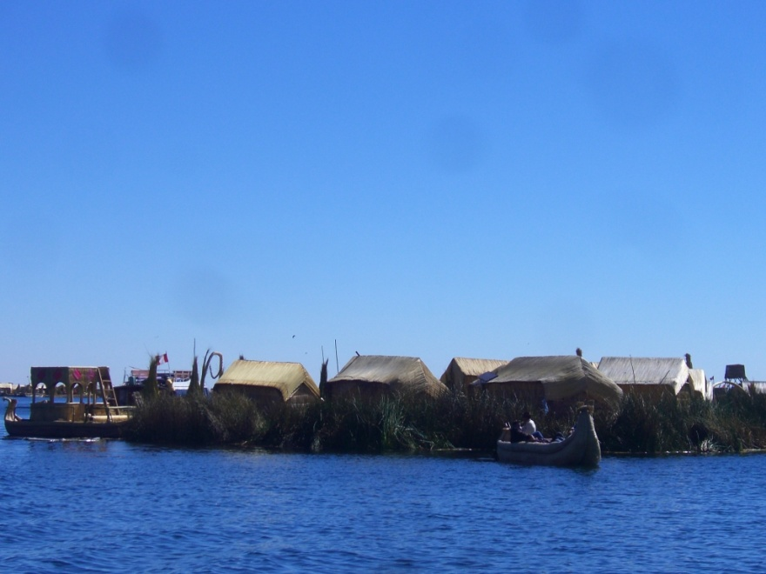
Day 8. Friday September 10. After breakfast we head to the port to board our boat bound for the Uros Island. In the afternoon after lunch we will go to Kutimbo. Overnight in Puno.

